Slide 1
April, 2025
PROJECT OVERVIEW
XRP Invitational
Rex, Cory, Kai

Slide 2
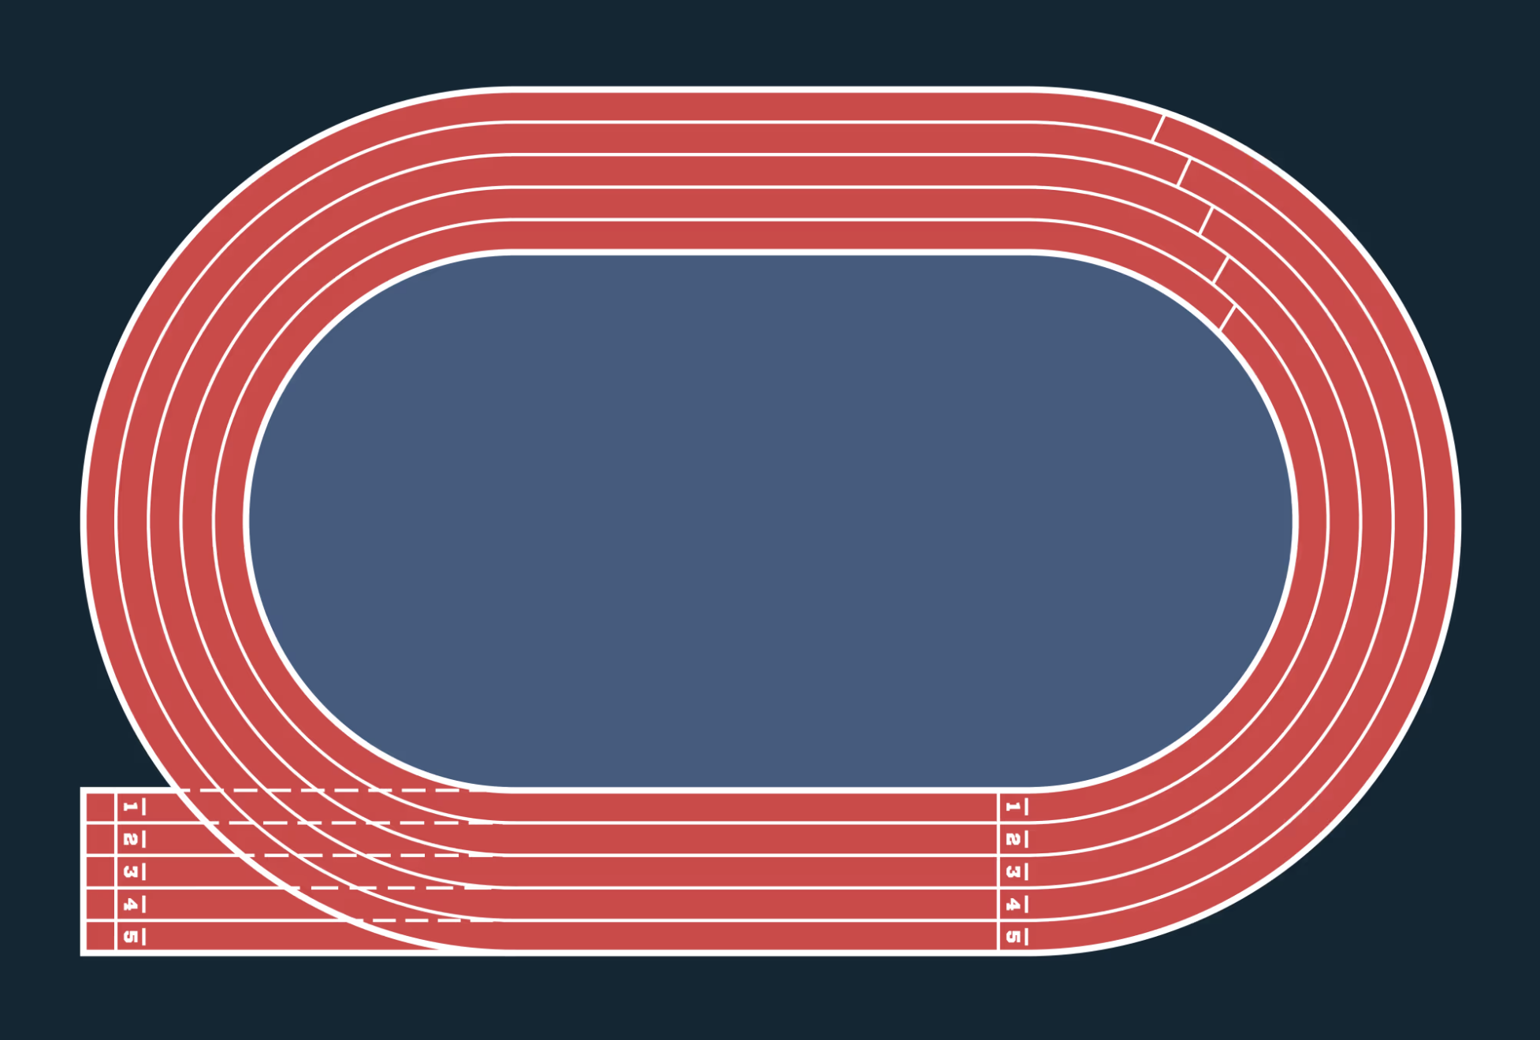
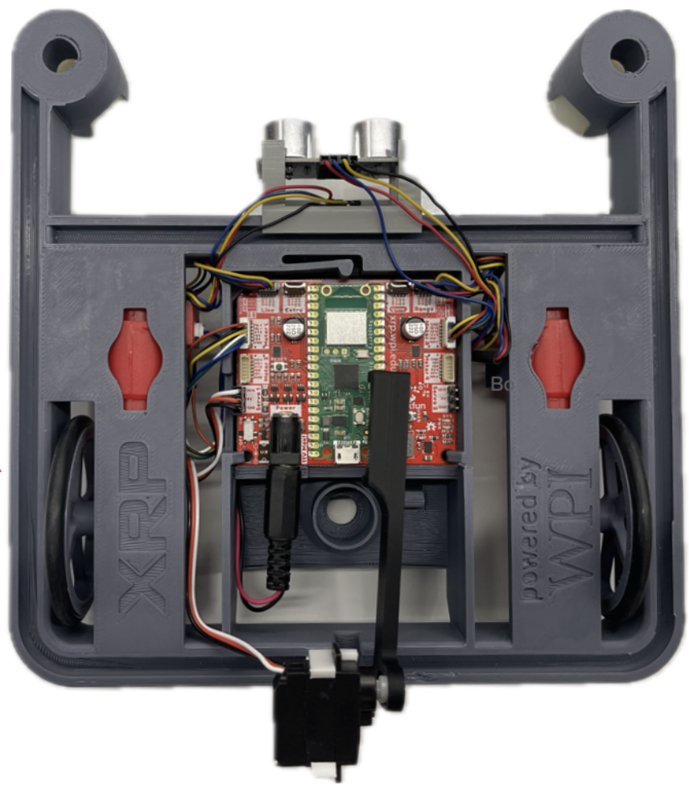
OUR VISION
XRPS are given a human inputted order via MQTT
Robots complete lap by moving onto track, finding the line and following around the circle
When close, robot will notify the next up via MQTT, “passing” the baton
Stretch goal: Implement a physical baton, passed between using a custom physical gripper
3
1
2

Slide 3
TIMELINE
Line following & MQTT communication
Demo of base goals
Gripper implementation
Demo day
4/18
4/25
5/5
5/9

Slide 4
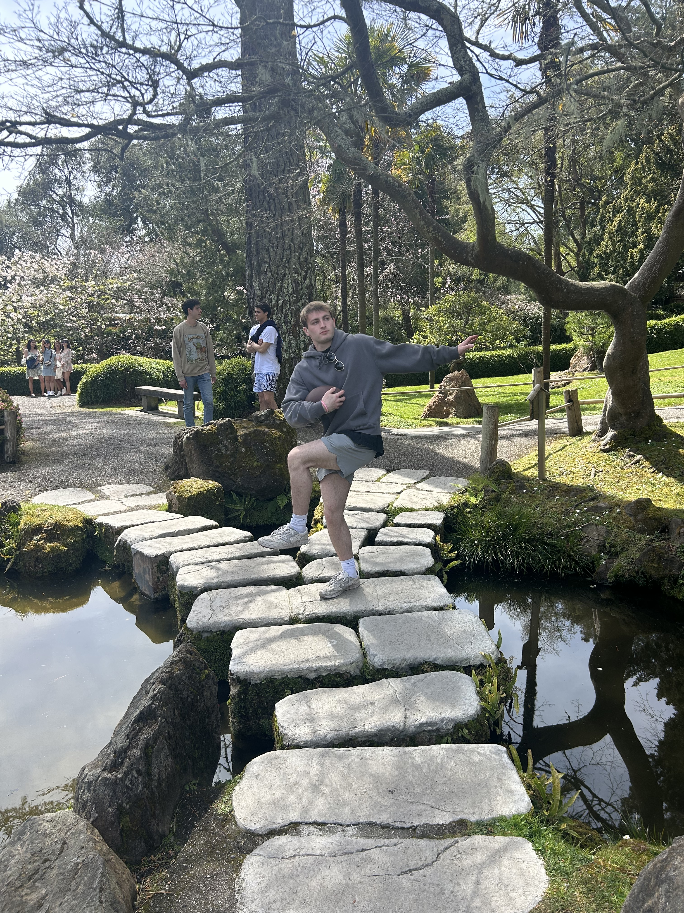
THANK YOU

